Slide 1

Analysis of Major League Baseball Performance Factors
Tyler Mazzagatte, Sports Analytics Student

Slide 2

Mike Trout’s Mysteries
Year | Age | Awards
2016 | 24 | AS,MVP-1,SS
2017 | 25 | AS,MVP-4
2018 | 26 | AS,MVP-2,SS
2019 | 27 | AS,MVP-1,SS
2020 | 28 | MVP-5,SS
2021 | 29 | AS
2022 | 30 | AS,MVP-8,SS

Slide 3
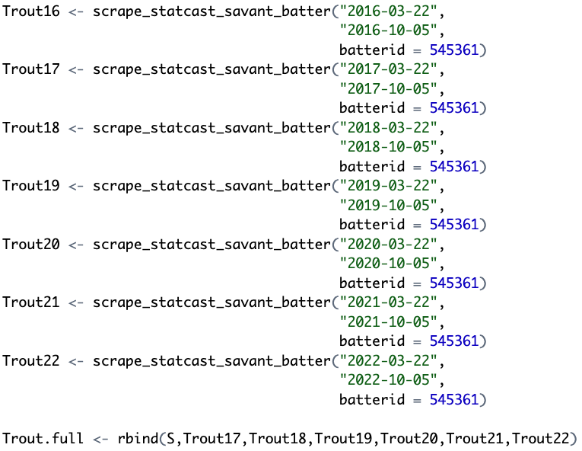
Performance Data
Balls in Play: Outs, Singles, Productive Outs, Doubles, Triples, and Home Runs
Variables: events, launch-angle, zone, release-speed, launch-speed, hit-distance, pitch-type, inning, outs-when-up, balls, and strikes

Slide 4
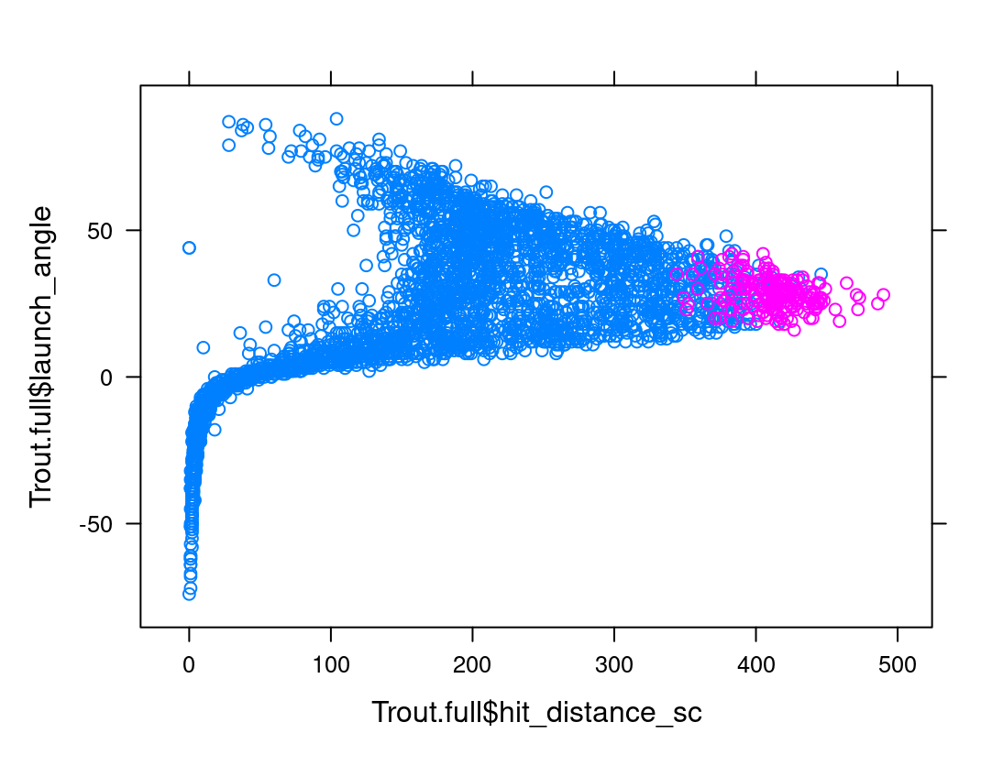
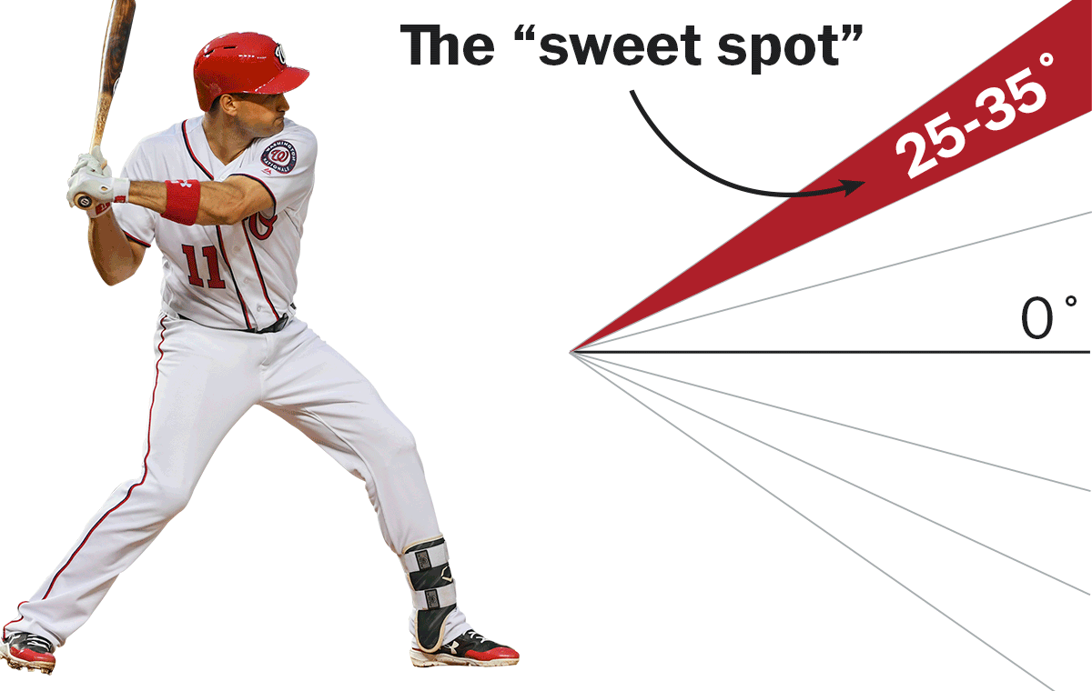
Launch Angle vs. Hit Distance

Slide 5
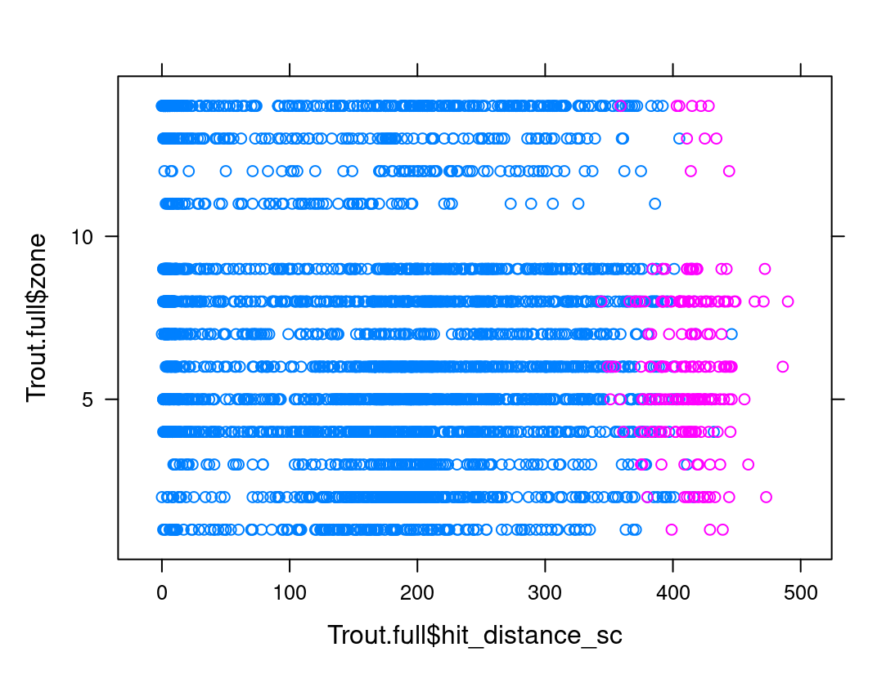
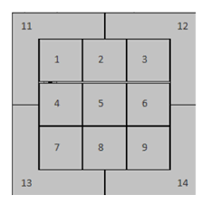
Zone vs. Hit Distance

Slide 6
Multiple Linear Regression
Variable | Estimate | Std. Error
(Intercept) | -0.31 | 0.565
launch_angle | -0.02*** | 0.001
zone | -0.03*** | 0.007
release_speed | -0.01 | 0.006
launch_speed | 0.01*** | 0.002
hit_distance_sc | 0.01*** | 0.000
outs_when_up | 0.02 | 0.031
inning | -0.00 | 0.009
pitch_type | 0.07* | 0.030
balls | 0.01 | 0.026
strikes | -0.06 | 0.035

Slide 7
Simple Linear Regression
Variable | Estimate | Std. Error
intercept | 2.52 | 0.448
release_speed | -0.02*** | 0.005
Variable | Estimate | Std. Error
intercept | 0.85 | 0.046
outs_when_up | -0.01 | 0.036
Variable | Estimate | Std. Error
intercept | 0.83 | 0.055
innings | 0.00 | 0.011
Variable | Estimate | Std. Error
intercept | 0.90 | 0.050
strikes | -0.06 | 0.036
Variable | Estimate | Std. Error
intercept | 0.83 | 0.045
balls | 0.01 | 0.027

